Slide 1
Joint Commission Ambulatory Care Accreditation Process
Alisha Morrison, Business Development Manager, The Joint Commission
December 2019
Notes:
Hello all! Thank you for listening into this webinar which will shed some light on our Joint Commission Ambulatory Care Accreditation process. My name is Alisha Morrison and I am business Development manager here at the Joint Commission and what that means is that I will be your point of contact to help you navigate through the Joint Commission accreditation and application process.

Slide 2
Welcome to The Joint Commission!
Notes:
I’d like to start off by saying welcome to all of the IMQ customers. We are really looking forward to working with you and partnering on your accreditation and beyond! My name is Alisha Morrison and I am business Development manager here at the Joint Commission and what that means is that I will be your point of contact to help you navigate through the Joint Commission accreditation and application process.

Slide 3

Agenda
Joint Commission Background
ASC Deemed Status
California Outpatient Surgical Settings
Preapplication process
Preparing for Survey
What to expect during your survey
Post Survey Process
Accreditation Investment
Getting to Gold - Resources
Notes:
Over the course of our time together we will be covering the joint commission background, steps to deemed status, what accreditation program the California outpatient surgical settings would fall under, the pre-application process, how to prepare for survey, what to expect during your survey, a review of the pricing breakdown and last, but not least the variety of free resources to help get you to gold!

Slide 4
Four Entities – One Vision
The Joint Commission
all people always experience the
safest
highest quality
best-value
health care across all settings.
Notes:
The Joint Commission is made up of four entities all united by a single vision and that vision is that all people always experience the Safest, highest quality, best-value health care across all settings

Slide 5

Ambulatory Health Care Accreditation
What’s Unique About Our Program
Robust state recognition of accreditation for licensure, spanning 34 states
29 states that require licensure for ambulatory surgery centers, rely on our accreditation program
22 states require accreditation as a criterion for providers operating office based surgery centers
Federal recognition of accreditation, CMS Deeming recognition for ambulatory surgery centers
Joint Commission ambulatory accreditation is recognized by CMS as a means to achieve Medicare certification.
Payer recognition of accreditation
Express Scripts recognition for Specialty Pharmacy for medical practice dispensaries that dispense specialty drugs.
Anthem recognition for federally-qualified health centers, birthing centers, convenient care centers, urgent care centers, ambulatory surgery centers, and dialysis centers.
Notes:
The Joint Commission’s ambulatory care program has been accrediting in the ambulatory care arena for almost 45 years and have had deeming authority for 24 years. We are nationally recognized by payors and currently have over 2,220 organizations accredited which equates to about 8,500 sites of care under our Ambulatory care program. In addition to accreditation we also offer additional certification options as well such as Orthopedic and Spine certification

Slide 6





About Ambulatory Care Surveyors
Ambulatory Health Care Accreditation
  Cadre of 50 surveyors: MD’s, RN’s, NP’s, and administrators with previous ambulatory experience
  Clinical experience: urgent care, surgery center administration, nursing, VA, podiatrist, surgeons, anesthesiologists, community clinics, internal medicine, dentists, radiologists
  “Employee” Surveyors – ambulatory care professionals, many employed in ambulatory settings and working as part-time surveyors
  Survey 30-120+ organizations annually
  Sources for Leading Practices & Education
Notes:
Our Ambulatory care surveyors all have vast ambulatory care experience and in fact many are still practicing to this day,
they are employees of the joint commission and survey anywhere from 30-120 or more organizations a year.
Because of this experience and our rigorous onboarding and annual training they are exceptional sources for leading practices and education for you and your team

Slide 7
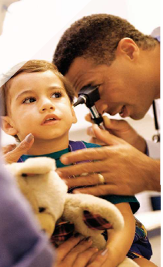
Who Can Apply?
Ambulatory Health Care Accreditation
Must be in the US or its territories. If not, operated by US government or under a charter
Has a license or registration to conduct services within its scope
Can demonstrate continuous improvement of it’s treatment, care or services
Identifies the services it provides directly, under contract or through some other arrangement
Provides services that can be evaluated under TJC standards
Must have served at least 10 total patients with two active at the time of survey
Procedures performed are ordered by a licensed independent practitioner
Notes:
We want to ensure that the ASCs applying for accreditation meet the minimum eligibility
so for instance they must be in the us, be able to demonstrate continuous improvement,
They must portray their services to the public clearly,
Our standards will need to be applied to their organization
Also, all of the procedures performed must be ordered or prescribed by an LIP.
And lastly, before we can come on site for the survey, the ASC must have served at least 10 total patients and have 2 active cases at the time of survey

Slide 8
ASC Deemed Status
Notes:
Now that we’ve learned a little bit about The Joint Commission and the Ambulatory care program lets dig into Deemed Status

Slide 9

Ambulatory Health Care Accreditation
  Accrediting ASCs since 1976
  ASC Deeming Authority since 1996
    CMS determined that The Joint Commission’s standards and survey process meet or exceed those established by CMS.
    ASCs accredited by The Joint Commission are eligible to be recognized by CMS for participation in the Medicare and Medicaid programs.
  Over 1,000 Accredited ASCs
  *Effective December 20, 2014 through December 20, 2020, CMS Renews Joint Commission Deeming Authority for Ambulatory Surgery Centers
Notes:
The Joint Commission has been granted Deemed Status by Medicare since 1996, this means that CMS has validated that The Joint Commission has standards and a survey process that meets Medicare’s requirements.
Surgery centers account for our largest customer and in fact we accredit over 1000 ASCs nationwide

Slide 10
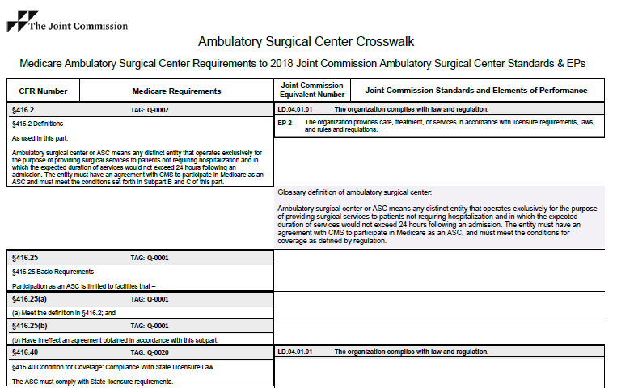
Deemed Status Facts
Built into survey process, survey evaluates both Joint Commission ambulatory care standards and additional Medicare Conditions for Coverage (CfCs)
Available CMS crosswalk in ambulatory care manual
Deemed ASCs will not need to undergo full CMS surveys
Provides a more educational survey experience
Includes a Life Safety Code surveyor
More time added for clinical support
Notes:
An ASC that would like to bill Medicare or Medicaid programs must:
Meet Conditions for Coverage (CfCs)
Earn certification from a:
State agency on behalf of the federal government, such as the Centers for Medicare & Medicaid Services (CMS)
OR
Received Deemed status from a National accrediting organization, such as The Joint Commission
When we complete your deemed status survey we are conducting the Joint Commission’s survey as well as Medicare’s simultaneously

Slide 11
ASCs Seeking Deemed Status
Know Additional CMS Requirements
Prepare
  List of surgical cases from 6 months prior to survey
  All hospital transfers from past 12 months
  Documents related to your infection control program
  Infection Control Worksheet (to be completed by surveyor on-site)
  Observation of at least two surgical procedures, one in its entirety, during the survey
Your survey will be unannounced–survey dates will not be provided to your facility (mandated by CMS).
CMS, not The Joint Commission, grants the final decision for Medicare certification.
Notes:
There are additional requirements needed in order to achieve deemed status
So for instance, You will want to ensure that you are meeting the additional CMS requirements.
Also, you will want to prepare a list of surgical cases from 6 months prior to survey, any hospital transfers, all documents related to your infection control program, and ensure you provide the infection control worksheet to the surveyor which they will fill out at the time of survey.
Finally at the time of survey, the surveyors will need to observe 2 surgical procedures

Slide 12
California Outpatient Surgical Settings
Notes:
The next type of organization I’d like to cover is the Outpatient Surgical Settings

Slide 13
California Outpatient Surgical Settings Subject to the Medical Board of California (MBC) accreditation mandate
Falls under The Joint Commission’s Office-Based Surgery (OBS) Program
OBS Eligibility Includes:
Limited to business occupancy: Defined as an occupancy that can only have three or fewer individuals at the same time, who are either rendered incapable of self-preservation in an emergency or are undergoing general anesthesia
Must be surgeon-owned or surgeon-operated
Provides invasive procedures to patients. Local anesthesia, minimal sedation, conscious sedation, or general anesthesia are administered
3 patients served, with at least 1 patient having a procedure at the time of survey
Notes:
What were commonly known under the IMQ program as Outpatient Surgical settings may be able to apply for Joint Commission Office based surgery program.
I quite frequently see organizations performing procedures such as plastic, pain mgmt. or even IVF apply for accreditation under this program.
An organization applying under this program would have to be surgeon owned or operated
And limited to business occupancy – which means that at any given time only 3 or less patients would be able to self-evacuate
In this next slide I will show some key differences between ASC and OBS accreditation

Slide 14

Key Differences: Office-Based Surgery (OBS) vs. ASC
OBS
ASC
Medicare Deemed Status option available
Business or Ambulatory Health Care Occupancy
Serve 10 patients with 2 active at the time of survey
Minimum of 2 Survey Days*
Cannot be used for Medicare Deemed Status
Business Occupancy
Serve 3 patients with 1 active at the time of survey
1 Day Survey
Day 1
Day 2
Day 1
Clinician
Clinician
Clinician
*Note: LSC added for ASCs with Ambulatory Health Care Occupancy
*based on annual case volume, in many cases, this may include an additional clinician day
LSC
Notes:
One of the biggest differences between the two programs is that OBS accreditation cannot be used for Medicare deemed status.
An OBS survey is announced and only lasts 1 day with 1 clinician surveyor and we will observe 1 active case
Whereas a survey for an ASC seeking deemed status is unannounced, we must observe 2 patients at time of survey and will commonly consist of a survey team of 3 ppl.
2 clinicians for 2 days and 1 LSC for 1 day

Slide 15
Pre-Application Process
Notes:
So now that we know a little more about the different types of accreditation lets talk about how you can apply for accreditation!

Slide 16




Pre-Application Process
Reach out to Joint Commission’s Ambulatory Care Business Development Manager – Alisha Morrison
amorrison@jointcommission.org
630-792-5234
Receive your complementary online access to online standards manual (e-dition)
Determine survey timeline with Business Development Manager
Complete application for accreditation with Business Development manager
Notes:
The very first step is to reach out to me! I’ve listed my contact information here on the slide, but please feel free to call me or send me an email to get started!
From there I will build you an account, get you access to an application as well as some resources such as the complimentary, online version of the standards manual, e-dition
We will also help you determine a survey timeline and finally I will help you complete the application from start to finish.
The application itself is extremely easy and all done on line it will take us about an hour to complete and just asks for high level information like your hours of operations, size of team members, types of cases being done and volume

Slide 17
Months leading up to survey
Preparing for Survey
Review Standards
Perform mock survey
Submit Application for accreditation (declare survey ready date)
Actual Joint Commission Survey
Identify consistency of current processes to Joint Commission requirements
Notes:
Once you submit your application you should begin reviewing our standards
The Joint Commission team has compiled a crosswalk of IMQ standards to our TJC standards to ensure your transition is as seamless as possible
From there you are ensuring your processes are consistent to our JCO requirements
You may want to even perform a mock survey to get your team comfortable with the survey process., We have a free survey activity guide which will act as your instruction guide as to how to perform a survey
Then you will wait for your joint commission survey

Slide 18
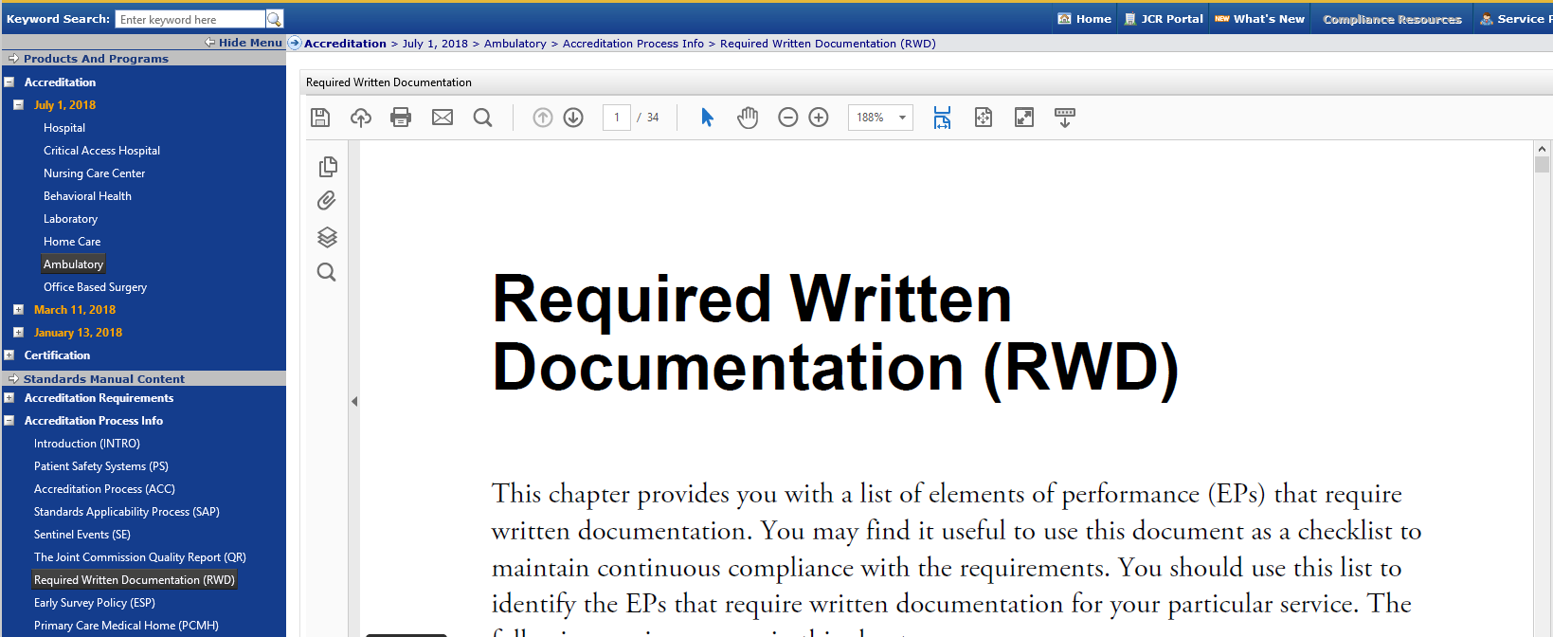
Required Written Documentation
Preparing for Survey
Notes:
When reviewing your standards and conducting your gap analysis, a great place to start is the require written documentation section of the manual.
You will know if we recquire some sort of written documentation for a standard because
You will see a D and a circle around it denoting that need for written documentation
This could be something as simple as an org chart or a written emergency plan or maybe even policies and procedures.

Slide 19
Ready to Go Binder
Preparing for Survey
Performance/Quality Improvement Data
Infection Control Surveillance Data
Infection Control Plan
Environment of care data, management plans, meeting minutes and annual evaluations
Organizational chart
Schedule of surgeries/procedures for each survey day
Notes:
To make you survey experience as smooth and effective as possible you will want to prepare “ready to go binders” a full list of documents that will need to be added to your ready to binder can be found in the survey activity guide but as a general rule of thumb you will want to ensure that you have things like your Infection control plan. Organizational charts, performance/quality improvement data
Always make sure your ready to go binder is easily accessible and up to date with all of the latest and greatest pieces of information

Slide 20
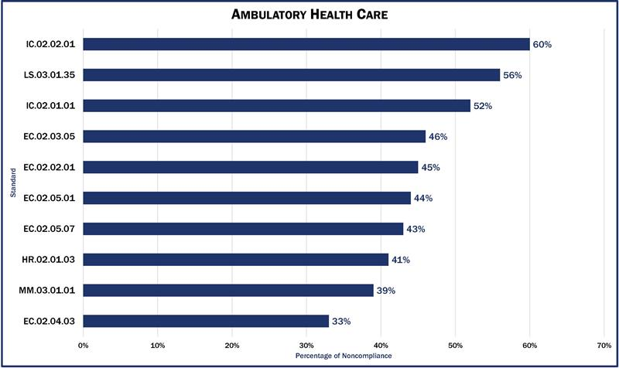
Most Common Findings
Preparing for Survey
AmBuzz – Top 10 Cited Standards with Compliance Tips:
http://bit.ly/2jX0LxM
Notes:
We want to see you succeed on your survey so twice a year we provide a chart that highlights the top 10 most challenging standards for our ambulatory partners. We typically post this in our blog called AmBuzz, a webinar as well as our various social media platforms and on our website so you can’t miss it! We also provide compliance tips to help you succeed during survey, a full list with those tips are located using the link on this slide

Slide 21
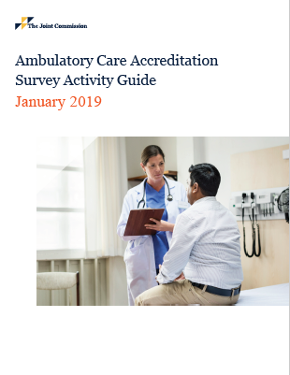
Survey Activity Guide
Preparing for Survey
Blueprint for the survey
Contains:
    Readiness guide
    Agenda
    Ready to go document list
    Activity list
Notes:
As mentioned, possibly one of your best resources for preparing for your survey will be your survey activity guide, I do not say this lightly let this be your guiding light it is a step by step instruction manual of what you and your team can expect from your survey.
It includes things like survey planning tools, the agenda as well as the document and activity lists

Slide 22
Survey Notification
Preparing for Survey
For initial, announced surveys
30 days prior to onsite visit via an automated email
For unannounced surveys (Deemed ASCs)
Assign staff to check your extranet site (Joint Commission Connect)
Notification available at 7:30 am morning of your survey
For all surveys
The organization has up to 15 black out days to use as “avoid dates” for survey
Notes:
For surveys that are announced you will receive a notice 30 days prior to our onsite visit via email
For unannounced surveys we will post at 7:30a on the day of your survey that we will be onsite that day which will give you about a 30 minute heads up!
It’s important to note here that YOU decide your survey ready date at the time that we submit your application together
At that time you will also have up to 15 black out days to use after your survey ready date. So for instance if your survey ready date is 1/1/19 but you will be on vacation after that, you have up to 15 black out days to mark down to ensure that we will not come on those days

Slide 23
What to Expect During your Survey
Notes:
So now that we’ve talked about how to apply and prepare for your survey lets talk about what to expect during your survey

Slide 24
Surveyor Arrival
Prepare a plan of action for staff to follow:
Confirming ID of the surveyor(s) and validation of survey
Who to notify upon their arrival
Location for the surveyors’ work area
Name badges
Parking
“Ready to Go” Binder
Notes:
Whether you know when your surveyor will be there or not, it is imperative to prepare a plan of action for staff to follow for when a surveyor comes on site.
The plan should include making sure your staff:
Confirms the ID of the surveyor(s) and the validation of survey
Who should your staff notify upon the arrival of the surveyors
Location for the surveyors’ work area (does not need to be a large space just somewhere where they can put down their laptop and charge it)
“Ready to go Binder” location

Slide 25
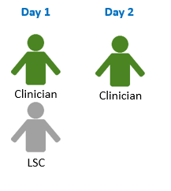
Survey Team – Deemed ASCs
Onsite Survey
Minimum 1 Ambulatory Care Surveyor for two days + 1 Life Safety Code Surveyor for 1 day
*based on annual case volume, in many cases, this may include an additional clinician day for volumes >300
Notes:
As a recap Your ambulatory care survey team can vary depending on the number of sites or patient visit volume of your organization
For example, ASCs seeking deemed status will typically have two surveyors for two days and one life safety code engineer for one day

Slide 26

Patient Tracer Methodology
Onsite Survey Overview
  Observation of direct patient care
  Review of clinical records
  Staff questions & dialogue
  Review of policies
  Observation related to:
    Infection control
    Environment of care
    Patient Safety Goals
  System Tracers
    Infection prevention
    Medication management
Notes:
One of the largest components of a survey is the patient tracer methodology. Patient tracers Account for nearly 2/3 of survey time, it helps the surveyor ‘connect the dots’ for your staff.
A surveyor will basically trace the patients experience from the time they enter your organization until they leave.
They will scrub in and observe at least two cases
Our surveyors will also conduct system tracers around infection prevention and medication management to ensure that your processes are sound and safe

Slide 27

Hints During the Survey
On-Site Process
It’s okay not to know the answer
Avoid the lip syncing act, let everyone be involved
Use this time to ask questions
Surveyors are reviewing systems, not individuals
Use the surveyor as a resource
Notes:
I know that sometimes organizations get a little nervous around survey time, so I wanted to share some of my best practices for a smooth survey!
First and foremost It’s okay not to know the answer
But know how to find the answer or someone that does!
Avoid the lip syncing act, let everyone be involved
Use this time to ask questions
Our surveyors are part of your team for two full days., Ask them for their input or what they have seen works well in other organizations
Always remind staff that we are not ever reviewing individuals. We are only reviewing the systems and procedures in place
Use the surveyor as a resource
Like I mentioned in the beginning of this webinar the entire cadre of surveyors have a vast amount of ambulatory experience and chances are they have seen solutions to some issues that may be burdening you and your staff! They would love to share their knowledge with you

Slide 28
Hints During the Survey
On-Site Process
The surveyors will notice things you don’t see
If they ask for materials, please find them ASAP
If changes are needed in the agenda, please ask
Time will go by very quickly
There are no surprises at closing
Notes:
Also, as a reminder, The surveyors will notice things you don’t see. Our surveyors are a fresh set of eyes so even if you’ve checked something over a thousand times you may have just missed it.
If your surveyor ask for materials or documents please find them asap, this will keep the survey on schedule
If changes are needed in the agenda, just ask they may be able to accommodate it!
Time will go by very quickly, make the most of it!
our goal is that there are no surprises at the end, we strive to make your survey a collaborative, inspirational and educational experience.

Slide 29
Post Survey Process
Notes:
Now that we know what to expect during your survey lets talk a little bit about the post survey process

Slide 30
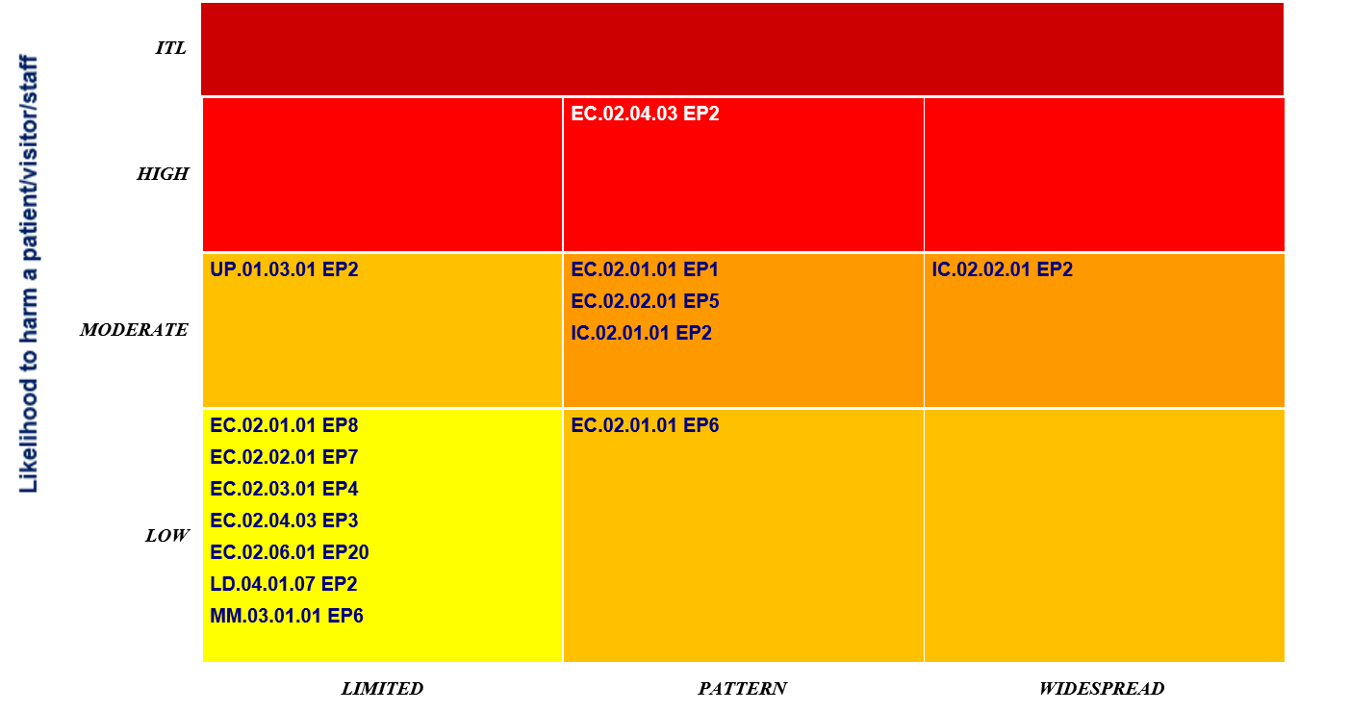
SAFER Matrix
Post Survey Process
  Organizations are scored via SAFER Matrix
  Findings placed within matrix according to likelihood to cause harm and the frequency of the observations
  Visualization of potential risk areas to the organization
Notes:
Starting in 2017 The Joint Commission unveiled the Safer Matrix. The Safer Matrix is basically a visual representation of the findings on your accreditation report. An example of the matrix is shown on this slide as you can see it is an easy way to view your findings and know which ones you should prioritize. On the X axis we have the scope, so how many times it was found and on the Y axis we have the likelihood to cause harm.

Slide 31

What happens after your survey?
Post Survey Process
Survey Reports will be posted within 5-7 business days
Clarification due within 10 days of survey closing date
Evidence of Standards Compliance (ESC) due 60 days following receipt of final survey report posted on JC Connect site
Final accreditation decision will be made after Joint Commission receives and approves the ESC
CELEBRATE
Use publicity kit to announce your accreditation
Notes:
Before we even leave your organization we will hold an exit conference with you and your other key accreditation team members.
Use this as an opportunity to sit down with the surveyors and review the report of findings.
Our surveyors work really hard to ensure that your time together is as collaborative as possible, so there should be no surprises at the end, but this is a good time if needed to have them answer any questions you may have about any citations.
The surveyor will then take that report with them though to finalize it before it is able to be viewed on your Joint commission connect site. This typically takes 5-7 business days
If there is still anything you don’t understand on your report you have 10 days from your closing date to request clarifications
From there your evidence of standards compliance are due within 60 days after your official report has been posted to the connect site
And then The final accreditation decision will be made after the joint commission receives and approves your evidence of standards compliance
Once you receive your certificate, it is time to CELEBRATEEEE
Once you have celebrated until your heart is content you should utilize the publicity kit to make your big announcement!
Take advantage of the Press release templates in there the logo and all of the other tools you have at your disposal

Slide 32
Accreditation
Investment
Notes:
Now that we’ve talked about the pre, intra and post survey process let’s take a peek at the accreditation costs.

Slide 33



Ambulatory Care Accreditation – Pricing
Special Considerations for IMQ-accredited organizations
Waiver of the application deposit fee of $1,700
10% discount on applicable annual fees for the initial 3-year accreditation period
Extended time period (e.g., 90 days from time of invoice) to make final accreditation fee payments
Notes:
We value your partnership and strive to make this transition from IMQ to Joint Commission as seamless as possible in efforts to aid your transition we are going to waive the one time deposit of $1,700
We are also happy to offer a 10% discount on your 1st cycle annual fees
Finally, we are extending the time period for when you will need to make your final accreditation fee payments

Slide 34
Ambulatory Care Accreditation – Pricing
Fee estimates
  Across three years
  Annual fee*
  Based on annual case volume
        Billed each January 1
        Initial applications: prorated based on timing of application
  On-site survey fee
        Based on number of surveyors/days
  *Discounted at 10% for IMQ Customers
Notes:
We allow organizations to pay their accreditation fees over the course of their 3 year cycle
Our pricing is broken down into a couple components: the annual fees and the onsite fees
These are deteremined by a few things: First if you are seeking deemed status and then if you are single or multi-specialty and then finally your annual case volume

Slide 35
Investment Breakdown
Onsite Fees
Annual Fee*
(x3 yrs.)
Total
3yr Investment
Year 1 (includes annual fee* and onsite fee)
Year 3 annual* fee
  *Discounted at 10% for IMQ Customers
Notes:
This is just a visual representation of the breakdown of fees.
If you would like a customized estimate for your facility please call or email me and I will be happy to provide that

Slide 36
Getting to Gold:
Resources for Readiness
Notes:
We really do want to ensure that this is a successful process for our customers so we have gathered a handful of resources for organizations to help them attain and maintain accreditation

Slide 37
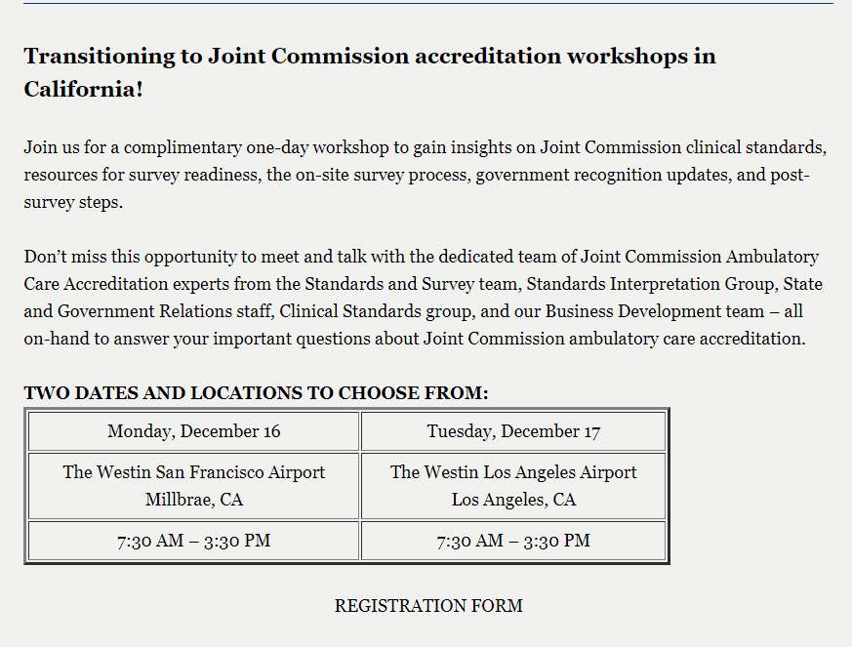
Resources:
Getting to Gold
  Two complimentary 1 day workshops in California
    Dec. 16th San Francisco
    Dec. 17th Los Angeles
  Reviewing the IMQ standards to Joint Commission Standards
  In-depth look at Survey process
  Compliance Tips
  Register via link below:
https://pages.jointcommission.org/AHC-2019-IMQ.html
Notes:
The first resource we have specifically for IMQ customers is an in person, complimentary workshop.
We will be hosting our first workshop in San Francisco on Monday, Dec. 16th and the second one on Tuesday Dec. 17th in Los Angeles
These will be hosted by team members from our Standards and Survey methods group as well as surveyors themselves.
We will walk through the IMQ to Joint commission standards and be happy to answer all of your questions here

Slide 38
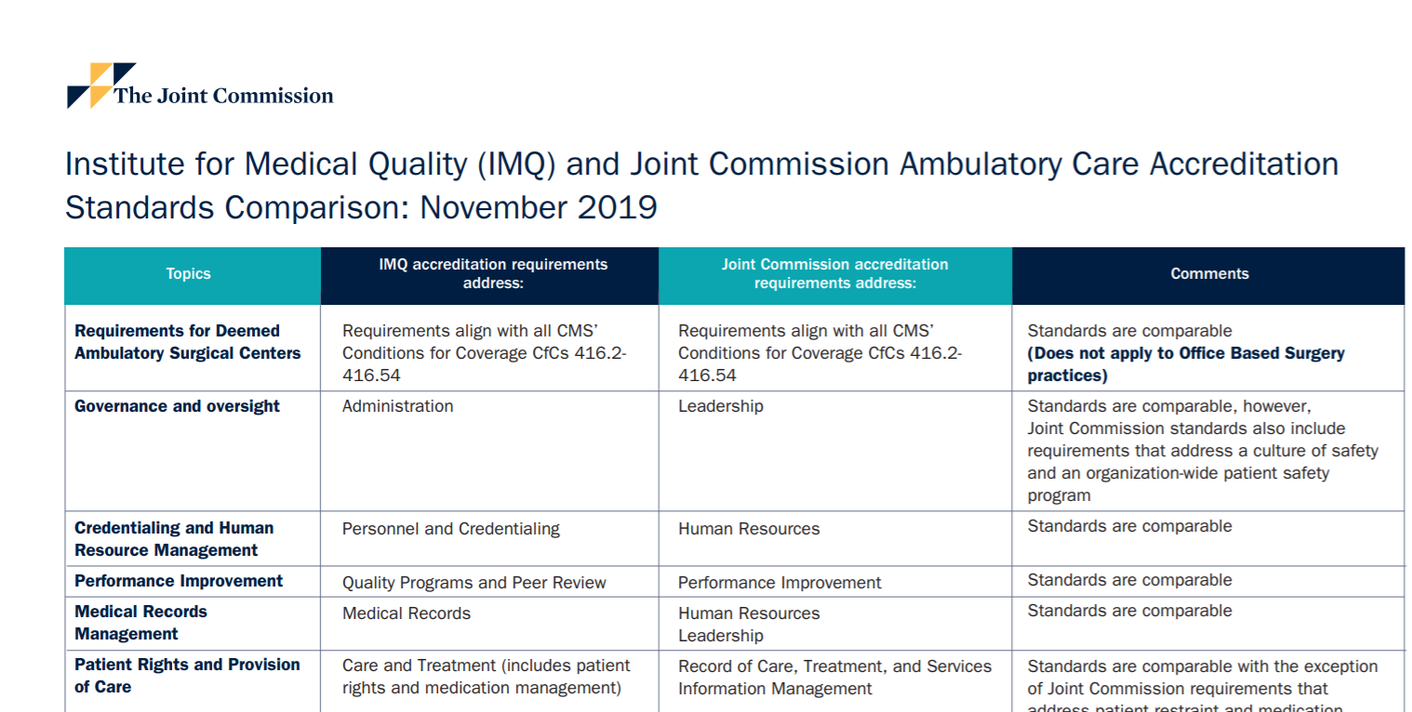
Resources:
Getting to Gold
  Crosswalk from IMQ standards to Joint Commission Standards
https://pages.jointcommission.org/AHC-2019-IMQ.html
Notes:
As mentioned in the slide before, our team has created an IMQ to Joint Commission Ambulatory care accreditation standards comparison so you can easily see which standards you are already meeting and how you can best meet our TJC standards

Slide 39

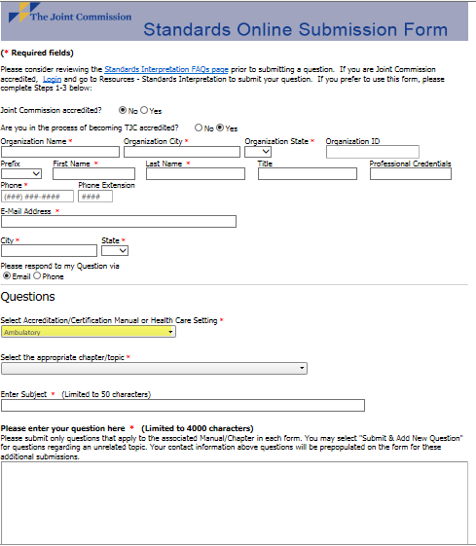
Resources:
Getting to Gold
Standards Support
  On-Line FAQs
  Standards Interpretation Group/Engineers
    Submit on-line form
Notes:
In addition to the above we also have a standards interpretation group that has a large bank of frequently asked questions from our customers.
However if you question is still left unanswered you can reach out to our standards interpretation group directly for any guidance on our standards and receive a call or an email back

Slide 40
  Survey Activity Guide
Getting to Gold
  Provides “blueprint” for survey
  Available on Joint Commission Connect once application is submitted
    Can be provided prior to submitting application
  Includes “Ready-To-Go” list template to assist pre-survey preparation
Notes:
I’ve talked about the Survey Activity guide a few times, but that’s only because aside from our standards it is one of our most important resources that organizations can dig into to ensure a smooth and successful survey.
It truly provides a blueprint of what you can expect, what you need to do during the various parts, what documents to have ready for the day and who you need to include during each section of the survey

Slide 41
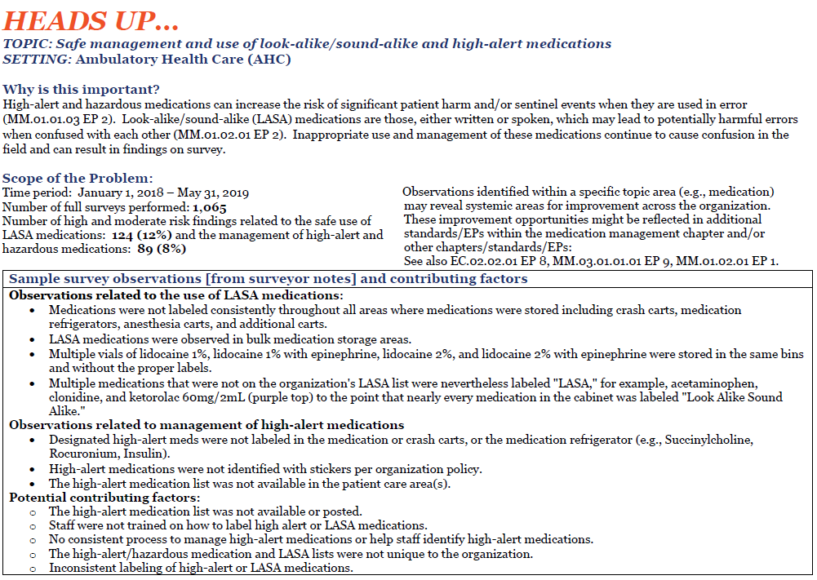
  Heads Up Report
Getting to Gold
  Heads-Up Reports (HUR) are a new survey readiness resource document.
  Each HUR identifies topics/themes that surveyors have noticed and cited while conducting recent surveys.
  The HUR provides examples of ways organizations can trace and uncover similar issues in their own organizations, and what factors may have contributed to the problem.
Notes:
The Heads up report is a new tool that we have for our customers. We will be tackling tough topics with leading practice solutions for each.
Our most recent HUR was on Medication Management and how to avoid any problems with LASA medications

Slide 42





Getting to Gold
  Developed by the Joint Commission Center for Transforming Health Care
  Innovative, online application
  Separate from Accreditation
  Complimentary to Joint Commission Accredited organizations
Guides
organizations in accurately
measuring their actual
performance
Identifies
barriers to excellence
performance
Directs
organizations to proven
solutions customized to
address particular barriers
Notes:
The TST are developed and maintained by the center for transforming healthcare and are free to joint commission customers.
They provide guidance and tools for your team on things like hand-off communications, safe surgery, hand hygiene and preventing falls

Slide 43
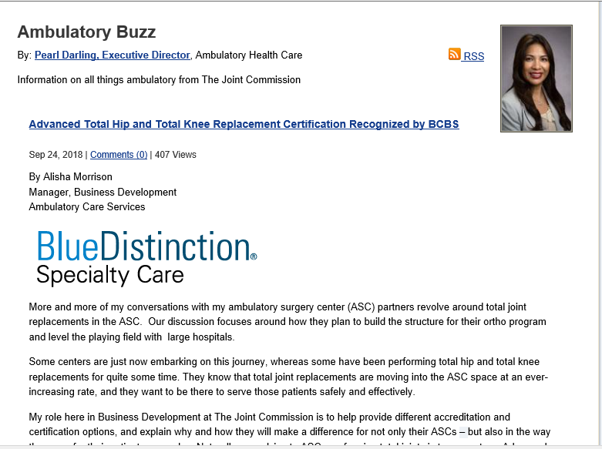

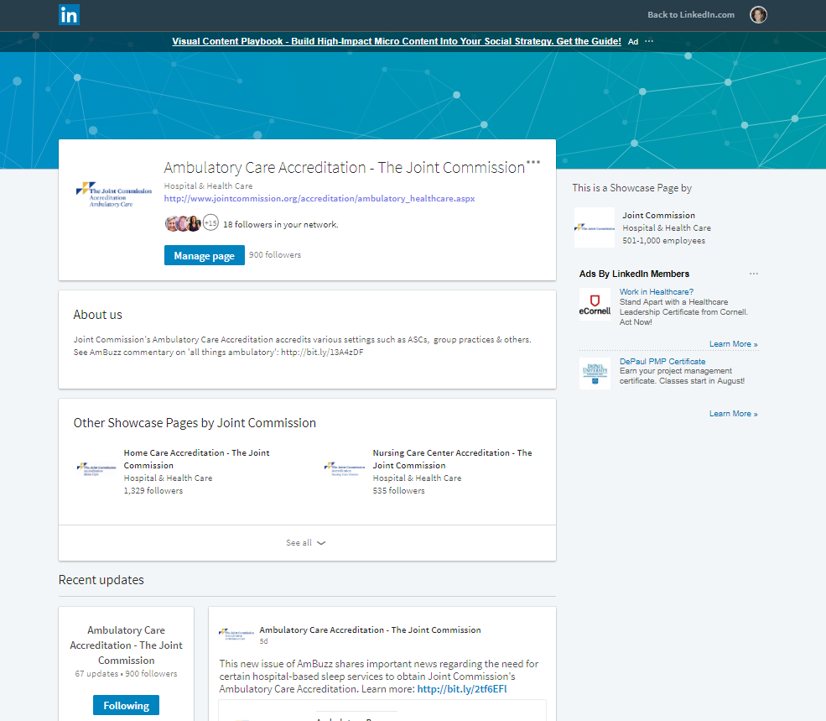
Industry News/Resources
Getting to Gold
  AmBuzz: Bi-Monthly Blog
  Ambulatory Care LinkedIn Showcase Page
  Ambulatory Care Twitter Feed
  Enterprise Content Library Index - contains links to current Joint Commission content, organized into typical topic areas in a searchable PDF
Notes:
We also have some industry resources for instance we write an twice monthly blog called AmBuzz that covers all different types of topics from new standards and survey methods
‘We are also very active on social media and frequently post updates about survey methods and standards

Slide 44
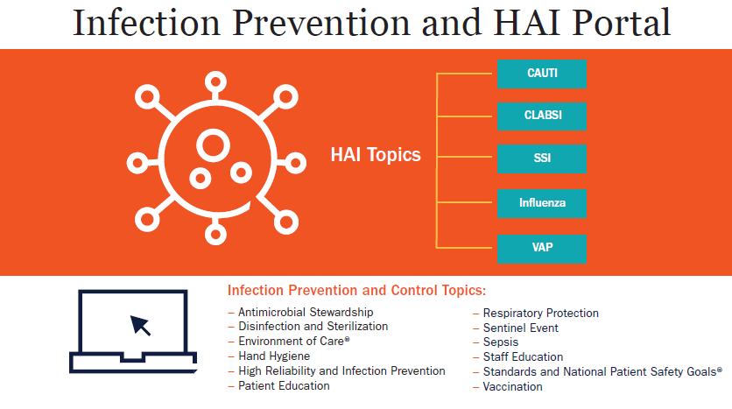
Ambulatory Care HAI Portal
Getting to Gold
See: http://bit.ly/2CaK9ue
Notes:
Over the years we have created a few portals for anyone to gain some additional information and support.
One of the most popular ones is our Infection prevention and Healthcare Associated infection portals
This covers topics around ABX, Disinfection and sterilization, Patient education, infection prevention and more.

Slide 45

Physical Environment Portal
Getting to Gold
See: www.jointcommission.org/JCPEP
Notes:
The next portal is the physical environment portal,
This was created in partnership with the American Society for Healthcare Engineering, and provides information to reduce findings of non-compliance in areas of Life safety code and EC
The portal focuses on Eight identified Standards and shares Best practices in the patient care environment and High Reliability practices for leadership to assess and ensure compliance

Slide 46
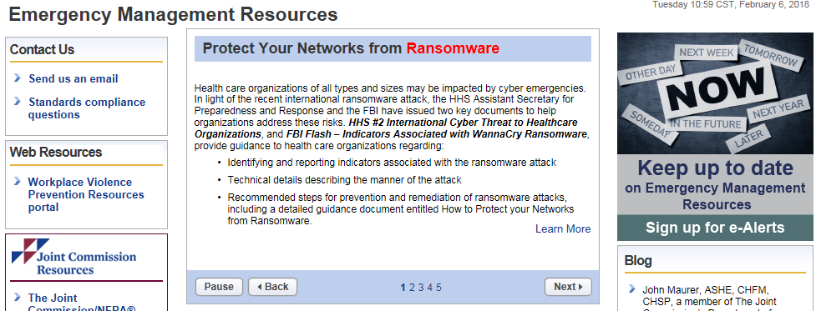
Emergency Management Portal
Getting to Gold
https://www.jointcommission.org/emergency_management.aspx
Notes:
The last of the three portals is the EM portal which contains tools and resources to help you practice EM drills, provides general references and more

Slide 47
Contact Information
Alisha Morrison
Business Development Manager
The Joint Commission
630-792-5234
amorrison@jointcommission.org
Notes:
Finally, you have myself! I am here to help answer any questions you may have about accreditation, process or timeline as well as provide you a customized pricing estimate. I’m also here to help you submit your application and provide you access to any of our free resources and standards.

Slide 48
Thank You!
Notes:
Last, but not least thank you for taking the time to listen to this webinar. I am excited to partner with you on your accreditation Journey with the Joint Commission and help you navigate through the first initial stages of the accreditation process. I can’t wait to speak with you or possibly meet you in California in December!

